Slide 1

NETWORK CONFIGURATION IN VIRTUAL ENVIRONMENTS WITH VIRTUAL BOX AND UBANTU
Project Guide : Dr. R.Subhashini, M.E, PH.D
Student Name : Himanshu Kumar
Register No : 40120128

Slide 2
Presentation Outline
I. Introduction
Briefly introduce the topic and the purpose of the project
Explain the importance of virtualization and its benefits
Provide an overview of the tools and technologies used in the project
II. Installation of Virtual Box
Explain the process of installing Virtual Box on your system
Describe the system requirements for Virtual Box
Walk through the steps to configure Virtual Box for the project
III. Installation of Ubuntu ISO
Explain the process of downloading and installing the Ubuntu ISO image
Discuss the different versions of Ubuntu available and their features

Slide 3
Presentation Outline
Provide step-by-step instructions for installing Ubuntu as an image in Virtual Box
IV. Creation of VM nodes
Explain the process of creating two VM nodes, Controller and Compute
Discuss the purpose and functionality of each node
Walk through the steps to configure each node in Virtual Box
V. Network Configuration
Explain the importance of network configuration in a virtualized environment
Discuss the different network modes available in Virtual Box
Provide step-by-step instructions for configuring the nodes in Bridge

Slide 4
Presentation Outline
Mode
VI. Testing and Troubleshooting
Explain the importance of testing and troubleshooting in a virtualized environment
Provide examples of common issues and their solutions
Walk through the steps to test the reachability of the VM nodes using the ping command
VII. Conclusion
Summarize the key points of the project
Discuss the benefits of virtualization and its potential applications
Provide recommendations for further exploration and learning.

Slide 5
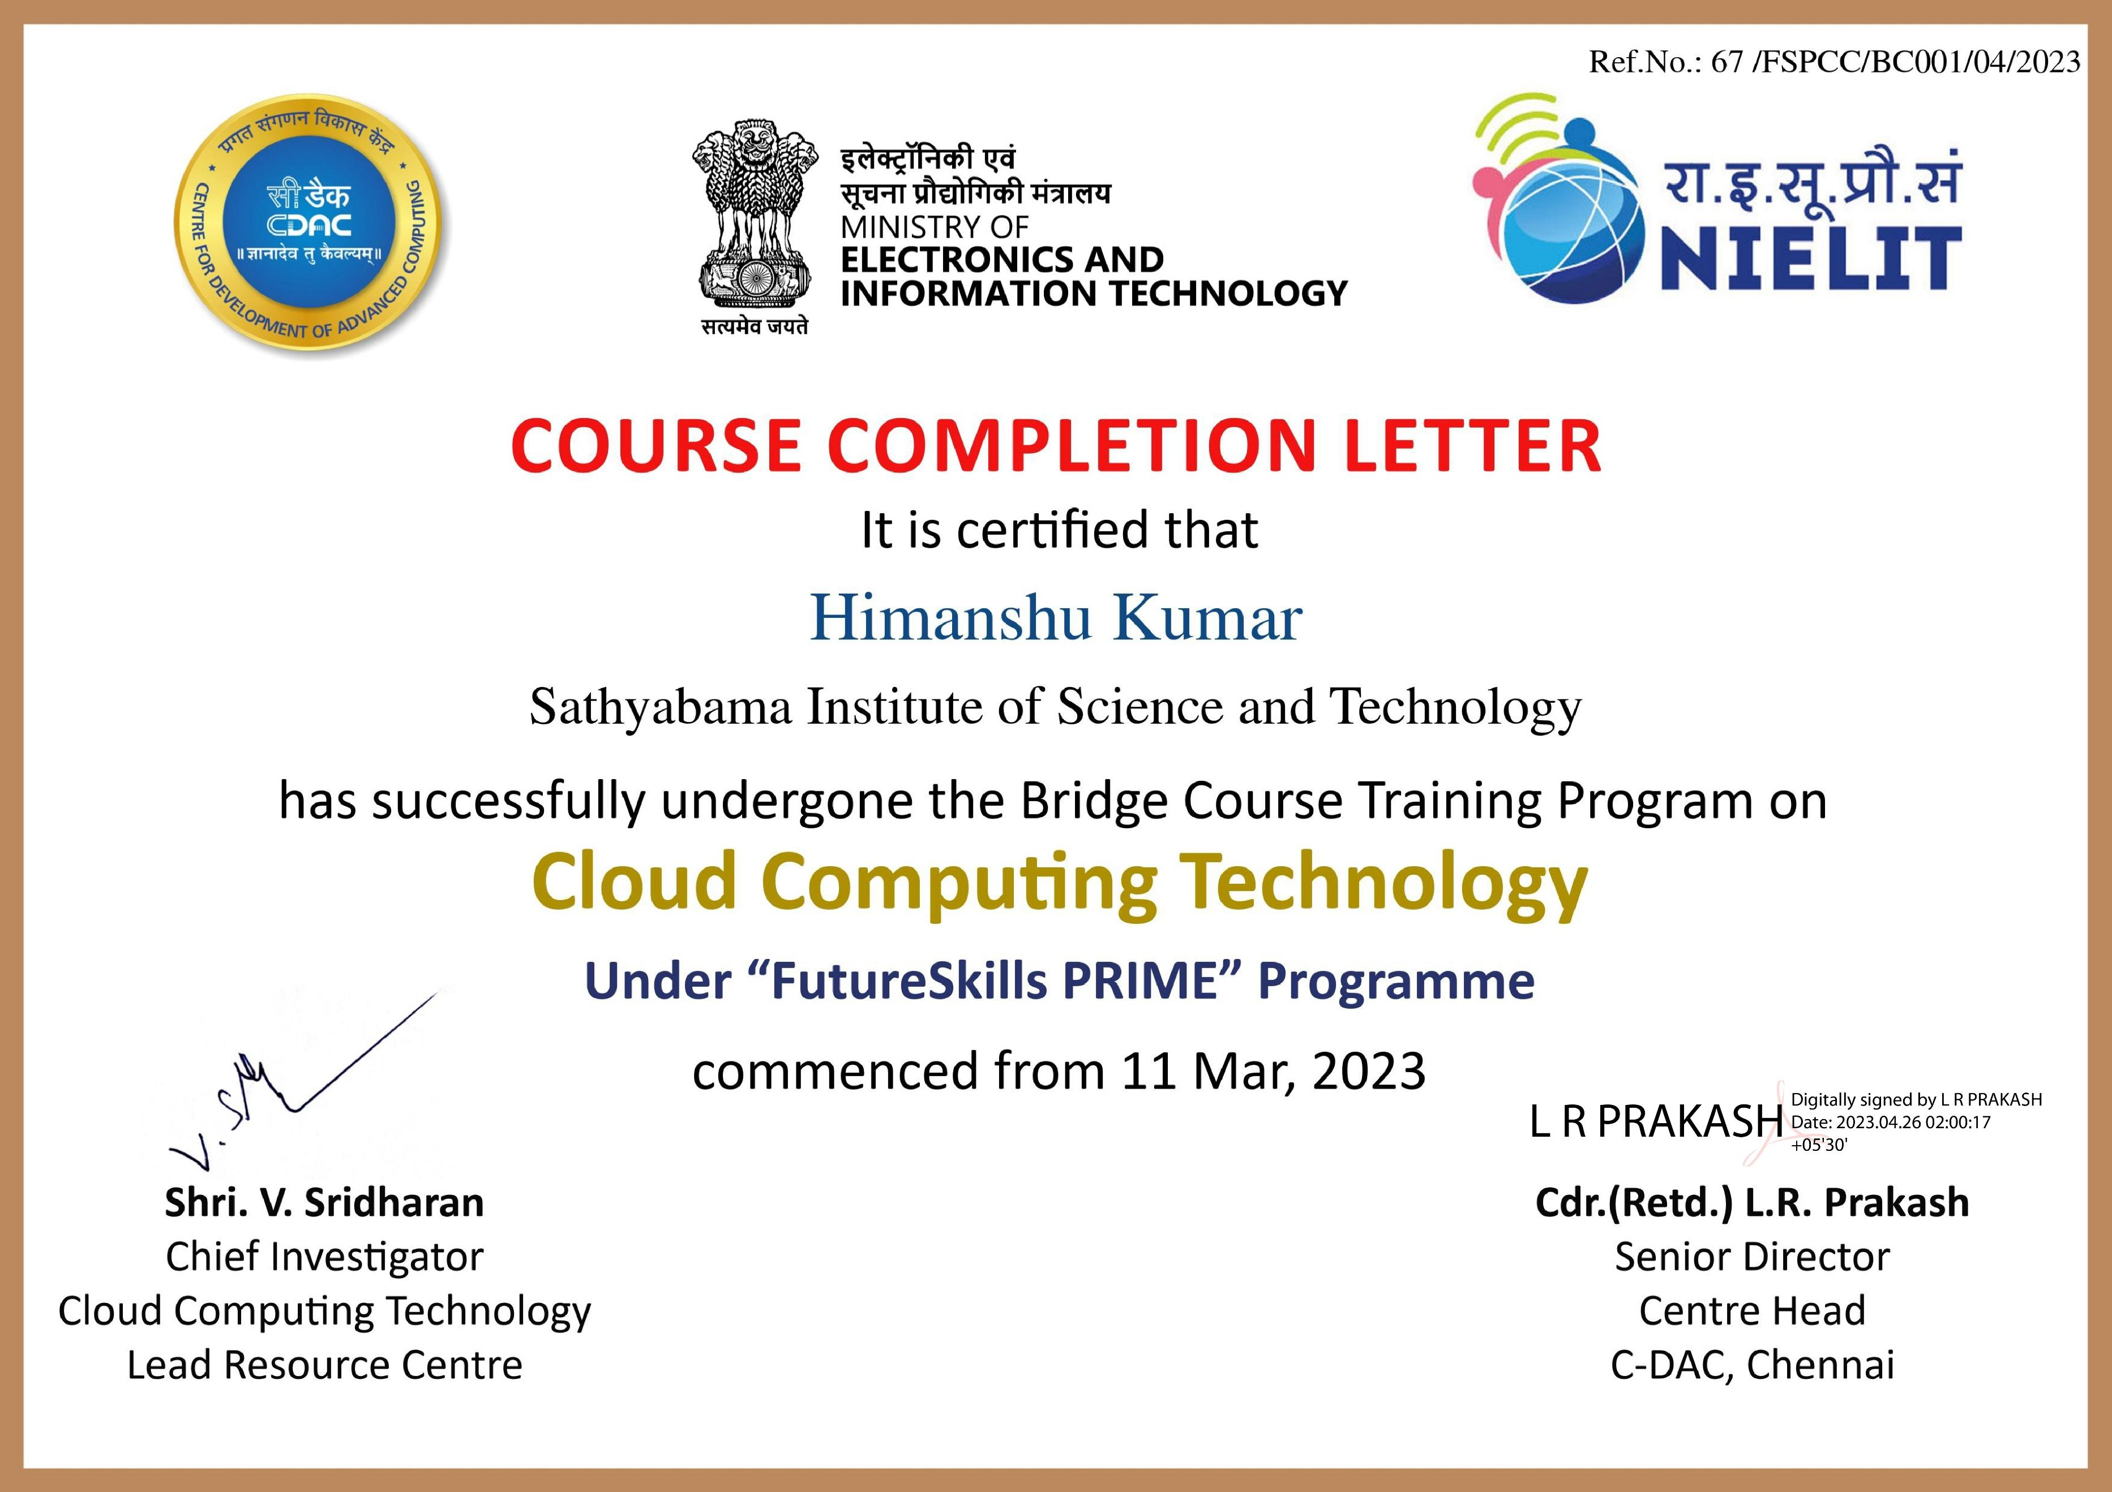
Course Certificate

Slide 6
Introduction
Virtualization creates virtual versions of OS, hardware, or resources
Virtual Box is free and open-source software for virtualization
Virtual Box allows running multiple OS on one machine
Ubuntu is an open-source Linux OS known for security, stability, and ease of use
Virtualization reduces hardware costs and improves resource utilization
Virtualization simplifies management and maintenance of systems

Slide 7
Objectives
Understand the different types of network adapters available in Virtual Box (e.g. NAT, Bridged, Host-Only)
Configure Virtual Box networking settings for the virtual machine
Install and configure network services in Ubuntu, such as DHCP or DNS servers
Assign IP addresses to the virtual machines and host machines
Configure firewall settings to allow network traffic to flow between the host and virtual machines
Test connectivity between the host machine and the virtual machines, and between virtual machines
Enable remote access to the virtual machines from other machines on the network
Implement network security measures, such as VLANs or VPNs, in the virtual environment
Monitor network traffic and troubleshoot any connectivity issues
Configure network settings for specific applications or services running within the virtual environment
Optimize network performance by adjusting network adapter settings or implementing load balancing
Configure network backups and disaster recovery plans
Document the network configuration for future reference or replication.

Slide 8
Project Implementation
Processor: Intel Core i5 or AMD Ryzen 5 processor or higher
RAM: 8 GB or higher
Hard disk space: 50 GB or higher
Network interface: Ethernet or Wi-Fi
Processor: Minimum 1 GHz; Recommended 2GHz or more.
Ethernet connection (LAN) OR a wireless adapter (Wi-Fi)
Please note that these are minimum requirements and you may need higher specifications depending on your workload and the number of virtual machines you plan to create. Additionally, you should also consider the hardware requirements of the guest operating system (in this case, Ubuntu) that you plan to install on the virtual machines

Slide 9
System Architecture / Ideation Map
Host machine runs Virtual Box software and hosts virtual machines
Virtual Box enables creation and management of virtual machines
Virtual machines have required configuration (CPU, memory, hard disk space, network adapters)
Each virtual machine requires virtual network adapter to connect to network
Virtual machines run Ubuntu OS instance
Virtual hard disks store OS and data of virtual machines
Virtual network adapters on virtual machines are configured to connect to network.

Slide 10
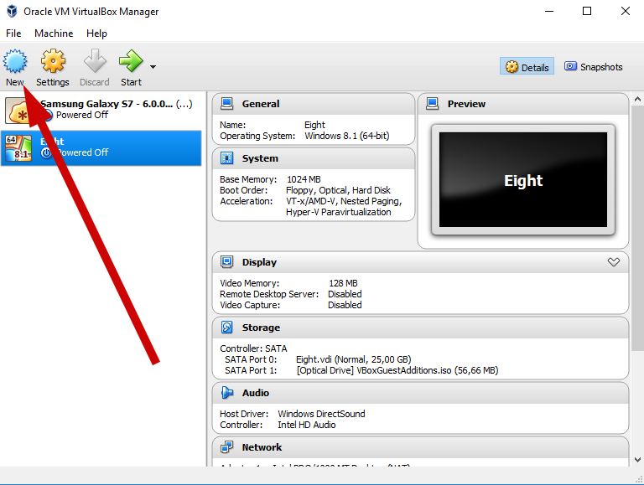
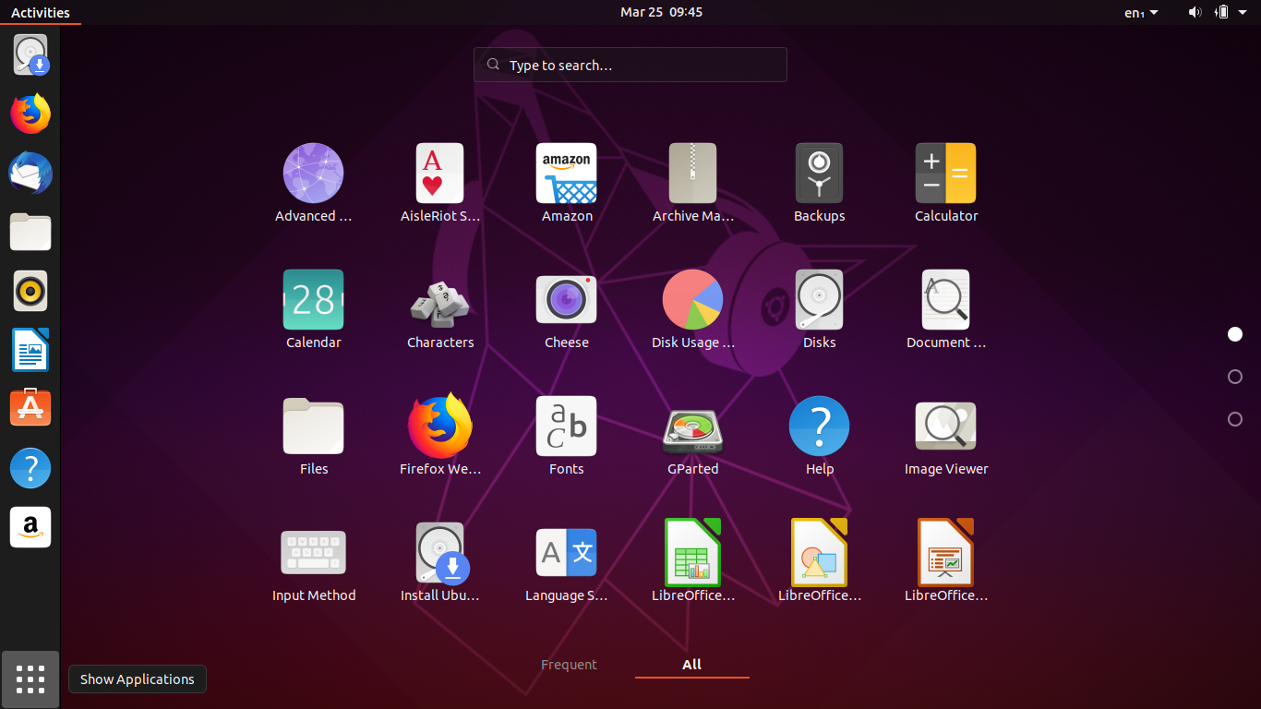
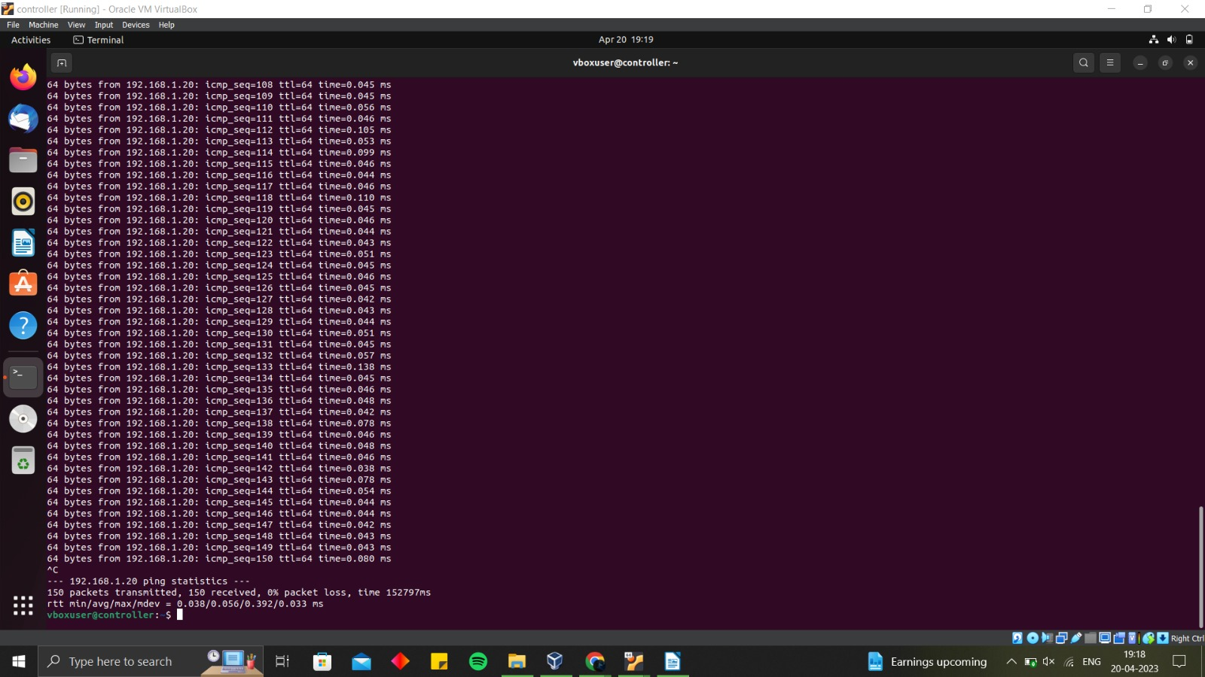
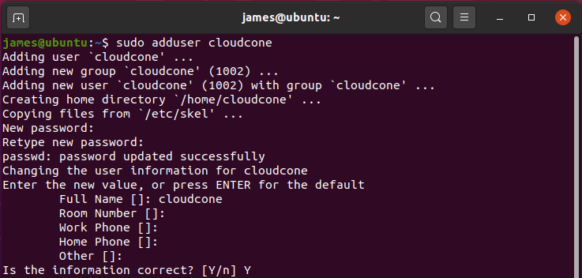
System Architecture / Ideation Map
Virtual box installation
Ubantu installation
output
nodes

Slide 11
Methodology
Identify hardware requirements for host machine
Install Virtual Box software on host machine
Download Ubuntu ISO image
Create virtual machine in Virtual Box, specifying CPU, memory, storage
Install Ubuntu on virtual machine by attaching ISO image
Configure network settings for virtual machine
Repeat steps 4-6 to create additional virtual machines
Manage virtual environment with Virtual Box (start/stop VMs, take snapshots, configure advanced settings)
Create Virtualized Ubuntu Environment with Virtual Box that meets requirements
Multiple virtual machines can run Ubuntu and connect to network
Flexible and scalable solution for running Ubuntu
Manage multiple virtual machines on a single physical machine

Slide 12
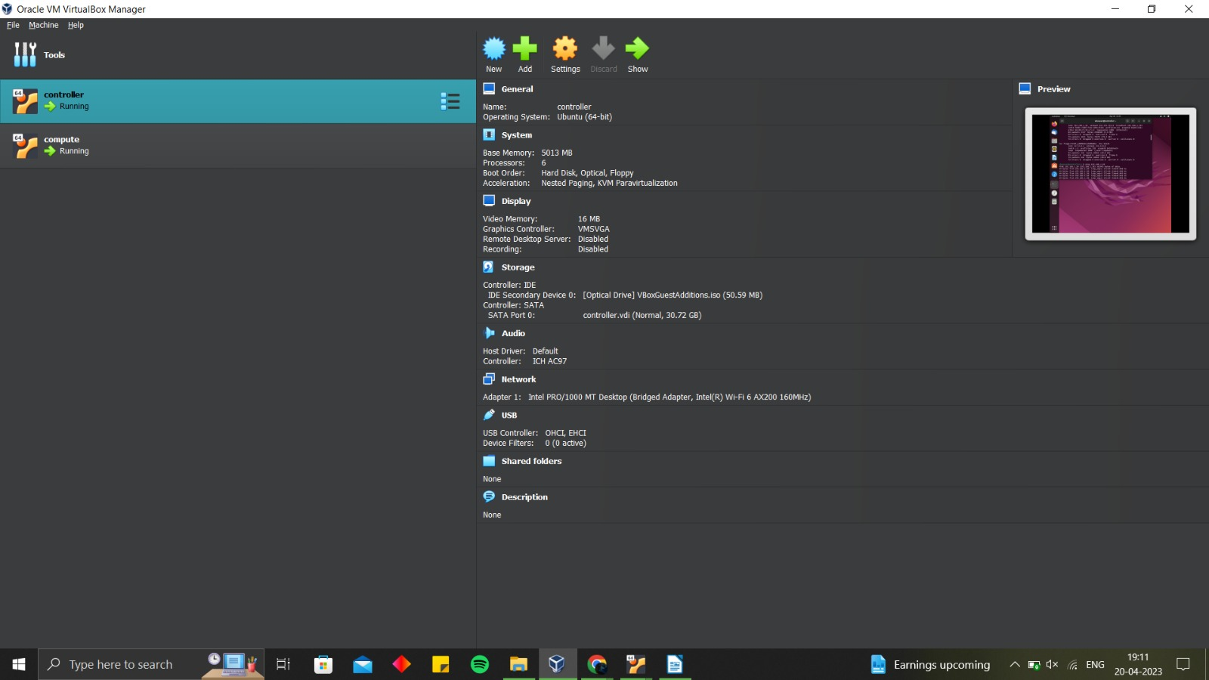
Snapshots
VMNODE 1

Slide 13
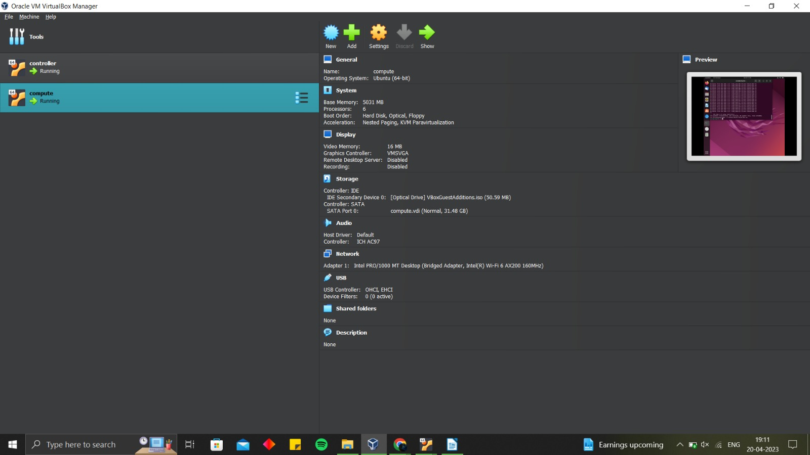
Snapshots
VMNODE 2

Slide 14
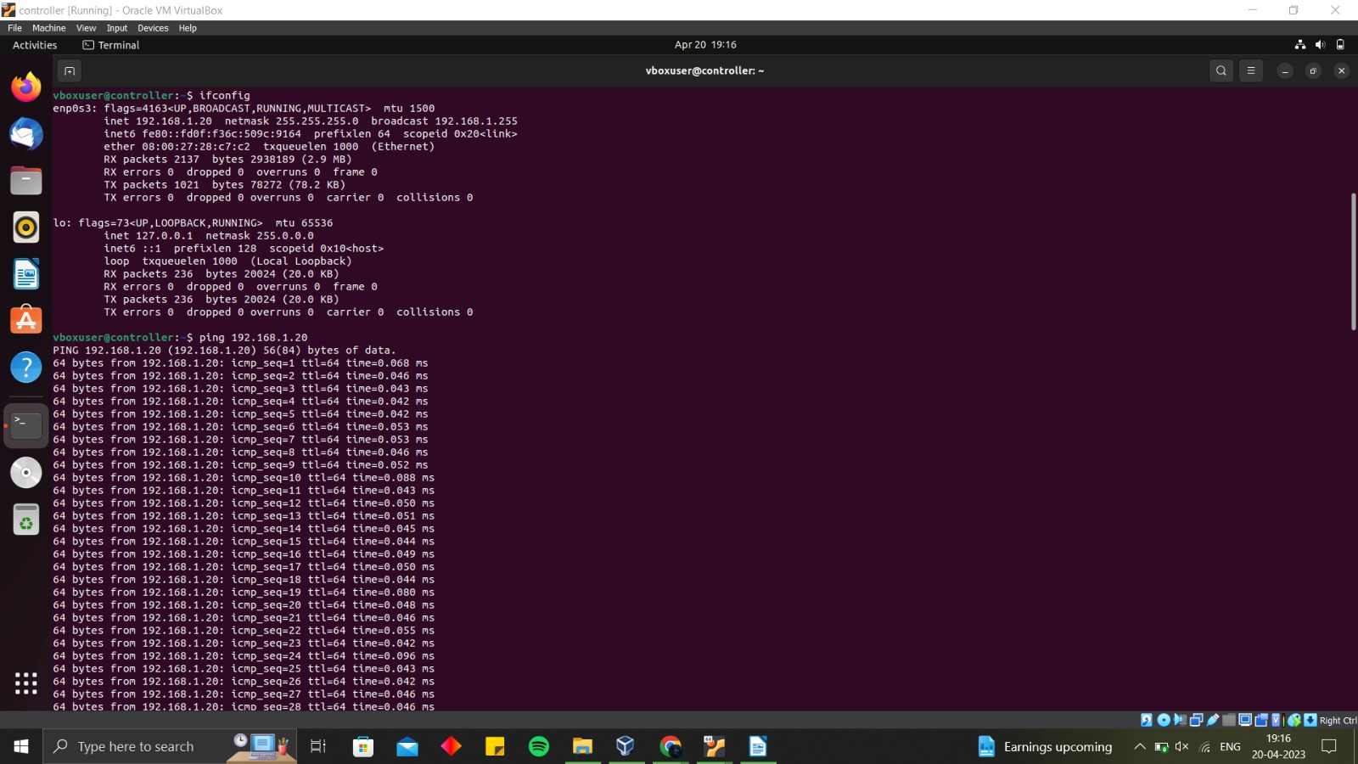
Snapshots
Command 1

Slide 15
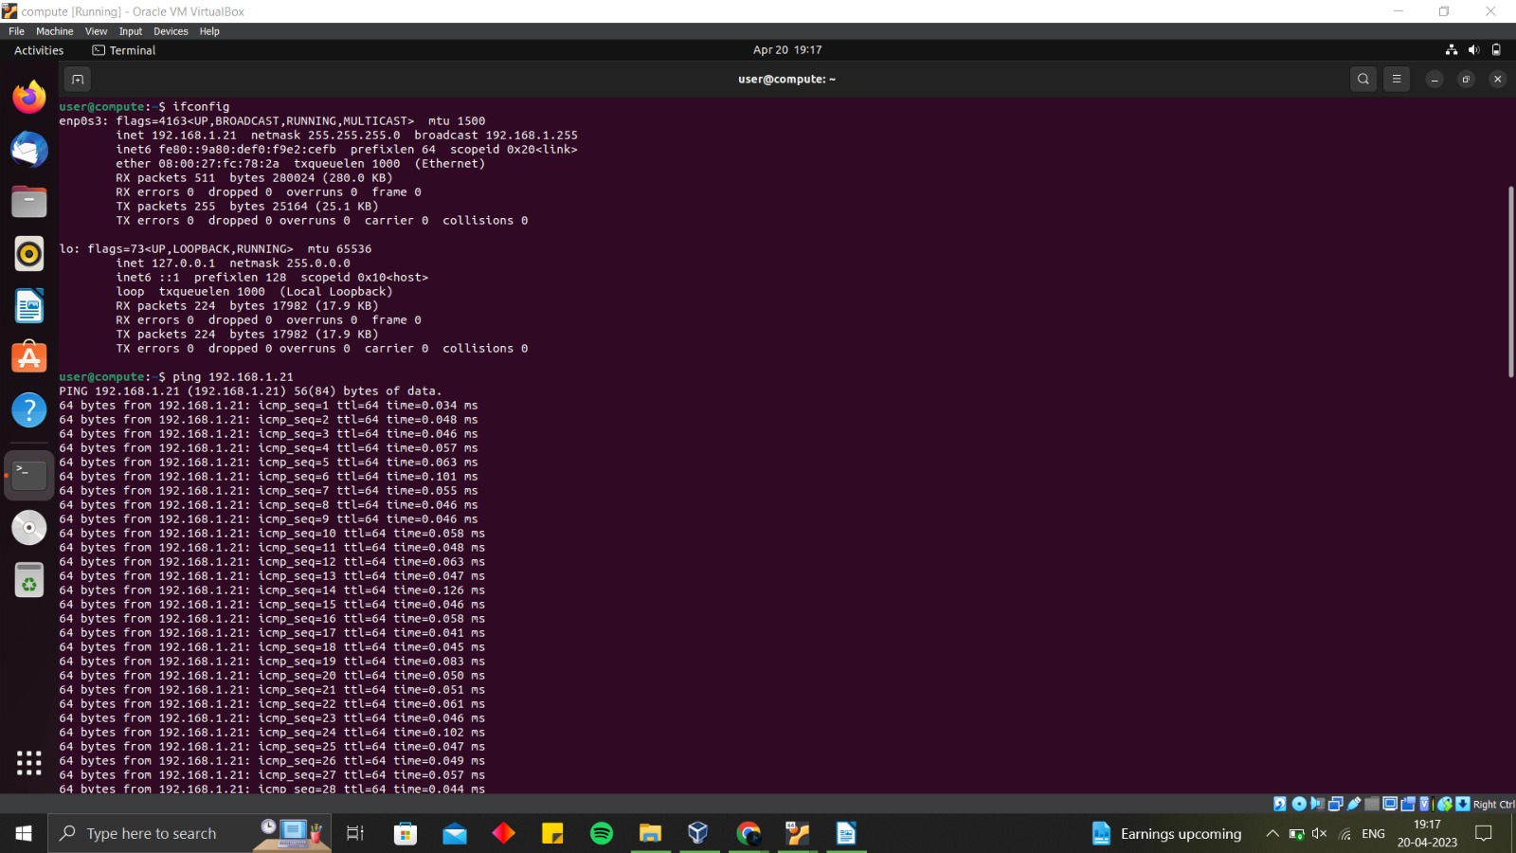
Snapshots
Command 2

Slide 16
Discussion
Presentation on creating virtualized Ubuntu environment with Virtual Box
Virtual Box is a popular virtualization software for running virtual machines
Benefits of using Virtual Box for Ubuntu environment:
Run Ubuntu alongside existing operating system
Experiment with Ubuntu and applications without affecting primary OS
Create multiple Ubuntu environments with different configurations
Useful for developers and system administrators to test software and network setups

Slide 17
Results

Slide 18
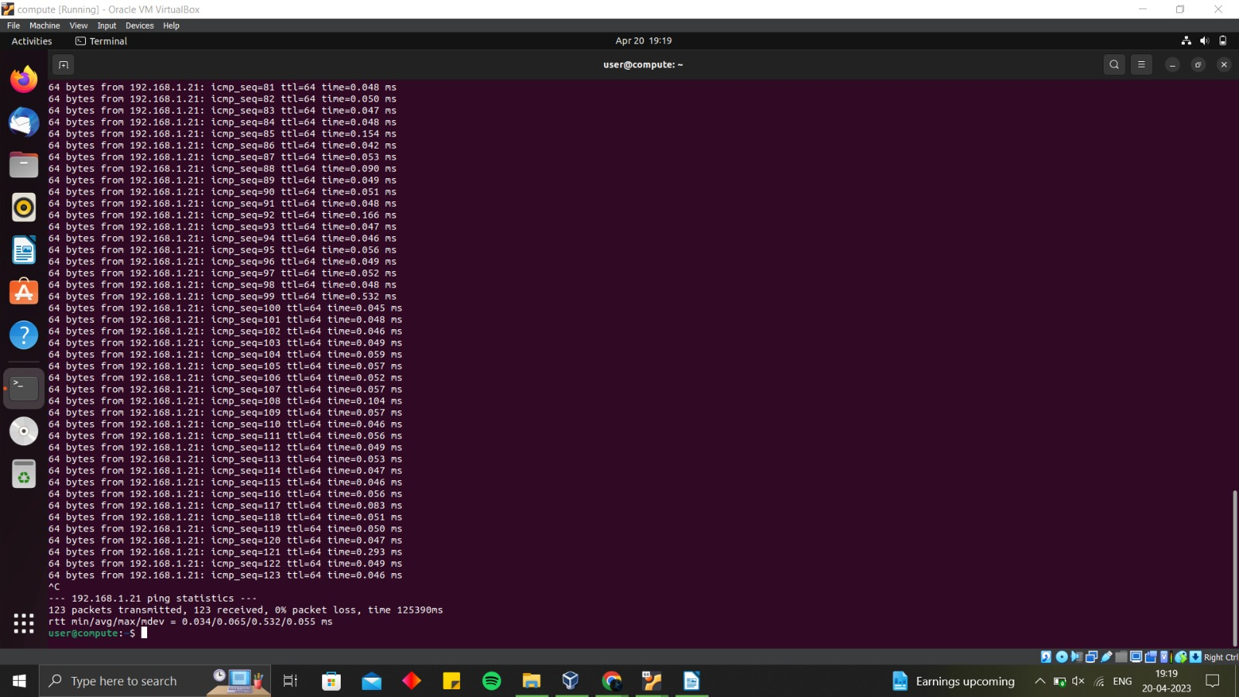
Results

Slide 19
Conclusion
Creating a virtualized Ubuntu environment with Virtual Box is a simple and effective way to experiment with Ubuntu and its applications.
Virtual Box provides a user-friendly interface and allows the creation of multiple Ubuntu environments with different configurations.
A virtualized Ubuntu environment is useful for developers, system administrators, and anyone who wants to learn more about Ubuntu without affecting their primary system.
Following the steps outlined in the presentation or discussion can help create a virtualized Ubuntu environment in minutes.
Benefits of a virtualized Ubuntu environment include the ability to test different software configurations and network setups.
Overall, a virtualized Ubuntu environment is a powerful tool for anyone looking to experiment with Ubuntu and its applications.
.

Slide 20
Reference
Virtual Box User Manual - Chapter 1: First Steps: https://www.virtualbox.org/manual/ch01.html
How to Install Ubuntu in VirtualBox: https://itsfoss.com/install-linux-in-virtualbox/
VirtualBox Documentation: https://www.virtualbox.org/wiki/Documentation
How to Create a Virtual Machine with VirtualBox: https://www.lifewire.com/create-a-virtual-machine-with-virtualbox-4169811
Ubuntu Documentation: https://help.ubuntu.com/
These resources provide detailed information on how to create and configure a virtualized Ubuntu environment using Virtual Box. They cover everything from installing Virtual Box and Ubuntu to configuring network settings and installing additional software.

Slide 21
Thank You

